Slide 1
Structured Query Language(SQL)

Slide 2
SQL Introduction
Database User
Database
Table
Constraints
Keywords
Data Types
Operators
Wildcard Characters
Joins
Aggregate Function
Views

Slide 3
Dates
Stored Procedures
Functions
String Functions in SQL Server
SQL Server Date Functions
Mathematical Functions in SQL Server
Temporary tables
Indexes
SQL Server Trigger
Backup and Restore

Slide 4
SQL is a query language used for accessing and modifying information in one or more data tables and rows of a database.
SQL is a non-procedural, English-like language that processes data in groups of records rather than one record at a time.
Few SQL functions of are:
Store data
Modify data
Retrieve data
Delete data
Create tables and other database objects

Slide 5
A Brief History of SQL
1970 − Dr. Edgar F. "Ted" Codd of IBM is known as the father of relational databases. He described a relational model for databases.
1974 − Structured Query Language appeared.
1978 − IBM worked to develop Codd's ideas and released a product named System/R.
1986 − IBM developed the first prototype of relational database and standardized by ANSI.
The first relational database was released by Relational Software which later came to be known as Oracle.

Slide 6
Facts of SQL:-
It was initially called SEQUEL( Structures Engliosh Query Language)
SQL is a powerful language that uses simple English sentences
SQL is declarative language.

Slide 7

What is Data?
Data is acollection of facts, figures and values from different sources.

Slide 8
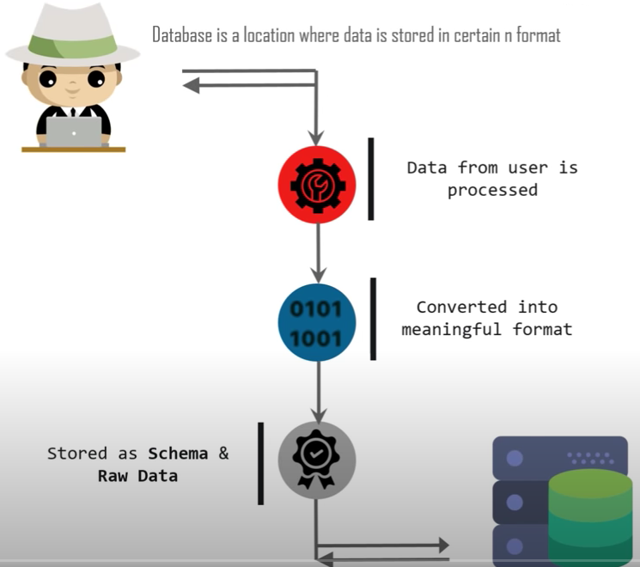
What sis the database?

Slide 9
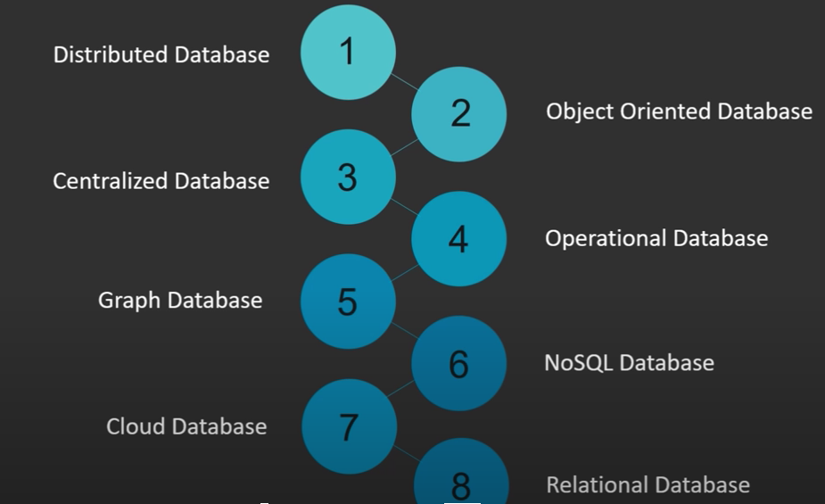
Types of database

Slide 10

New popular databases are

Slide 11
SQL is a language that is used to communicate with database.
MySQL workbrench is a DBMS it allows SQL to communicate with database.
Query Language DDL, DML, DCL:-
Query language (QL) refers to any computer programming language that requests and retrieves data from database and information systems by sending queries.
It works on user entered structured and formal programming command based queries to find and extract data from host databases.

Slide 12
Data-definition language (DDL): The SQL DDL provides commands for defining relation schemas, deleting relations, and modifying relation schemas.
Command & Description
CREATE Creates a new table, a view of a table.
ALTER Modifies an existing database object, such as a table.
DROP Deletes an entire table, a view of a table or other objects in the database.

Slide 13
Interactive data-manipulation language (DML): The SQL DML includes a query language based on both the relational algebra and the tuple relational calculus.
It includes also commands to insert tuples into, delete tuples from, and modify tuples in the database.
Command & Description
SELECT Retrieves certain records from one or more tables.
INSERT Creates a record.
UPDATE Modifies records.
DELETE Deletes records.

Slide 14
DCL - Data Control Language
Command & Description
GRANT Gives a privilege to user.
REVOKE Takes back privileges granted from user.

Slide 15
TCL(transaction Control Language) : TCL commands deals with the transaction within the database.
COMMIT– Commit command is used to save all the transactions to the database..
ROLLBACK– rollbacks a transaction in case of any error occurs.
SAVEPOINT–sets a savepoint within a transaction.
SET TRANSACTION–specify characteristics for the transaction.

Slide 16
Database:-
Database Design is a collection of processes that facilitate the designing, development, implementation and maintenance of enterprise data management systems.
Properly designed database are easy to maintain, improves data consistency and are cost effective in terms of disk storage space.
The database designer decides how the data elements correlate and what data must be stored.
The main objectives of database designing are to produce logical and physical designs models of the proposed database system.

Slide 17
The logical model concentrates on the data requirements and the data to be stored independent of physical considerations.
It does not concern itself with how the data will be stored or where it will be stored physically.
The physical data design model involves translating the logical design of the database onto physical media using hardware resources and software systems such as database management systems (DBMS).

Slide 18
Database development life cycle

Slide 19

Database Techniques
Normalization
ER Modeling

Slide 20
Data Types
Data types define the nature of the data that can be stored in a particular column of a table
MySQL has 3 main categories of data types namely
Numeric
Text
Date/time.

Slide 21
Numeric Data types
Numeric data types are used to store numeric values. It is very important to make sure range of your data is between lower and upper boundaries of numeric data types.
TINYINT( ) | -128 to 127 normal 0 to 255 UNSIGNED.
SMALLINT( ) | -32768 to 32767 normal 0 to 65535 UNSIGNED.
MEDIUMINT( ) | -8388608 to 8388607 normal 0 to 16777215 UNSIGNED.
INT( ) | -2147483648 to 2147483647 normal 0 to 4294967295 UNSIGNED.
BIGINT( ) | -9223372036854775808 to 9223372036854775807 normal 0 to 18446744073709551615 UNSIGNED.
FLOAT | A small approximate number with a floating decimal point.
DOUBLE( , ) | A large number with a floating decimal point.
DECIMAL( , ) | A DOUBLE stored as a string , allowing for a fixed decimal point. Choice for storing currency values.

Slide 22
Text Data Types
As data type category name implies these are used to store text values. Always make sure you length of your textual data do not exceed maximum lengths.
CHAR( ) | A fixed section from 0 to 255 characters long.
VARCHAR( ) | A variable section from 0 to 255 characters long.
TINYTEXT | A string with a maximum length of 255 characters.
TEXT | A string with a maximum length of 65535 characters.
BLOB | A string with a maximum length of 65535 characters.
MEDIUMTEXT | A string with a maximum length of 16777215 characters.
MEDIUMBLOB | A string with a maximum length of 16777215 characters.
LONGTEXT | A string with a maximum length of 4294967295 characters.
LONGBLOB | A string with a maximum length of 4294967295 characters.

Slide 23
Date / Time
DATE | YYYY-MM-DD
DATETIME | YYYY-MM-DD HH:MM:SS
TIMESTAMP | YYYYMMDDHHMMSS
TIME | HH:MM:SS
DATE | YYYY-MM-DD
DATETIME | YYYY-MM-DD HH:MM:SS
TIMESTAMP | YYYYMMDDHHMMSS
TIME | HH:MM:SS

Slide 24
Operators
Operators are used to specify conditions in an SQL statement and to serve as conjunctions for multiple conditions in a statement.
Arithmetic operators
Comparison operators
Logical operators

Slide 25
Arithmetic Operators
Assume 'variable a' holds 10 and 'variable b' holds 20, then −
Operator | Description | Example
+ (Addition) | Adds values on either side of the operator. | a + b will give 30
- (Subtraction) | Subtracts right hand operand from left hand operand. | a - b will give -10
* (Multiplication) | Multiplies values on either side of the operator. | a * b will give 200
/ (Division) | Divides left hand operand by right hand operand. | b / a will give 2
% (Modulus) | Divides left hand operand by right hand operand and returns remainder. | b % a will give 0

Slide 26
Comparison Operators
Operator | Description | Example
= | Checks if the values of two operands are equal or not, if yes then condition becomes true. | (a = b) is not true.
!= | Checks if the values of two operands are equal or not, if values are not equal then condition becomes true. | (a != b) is true.
<> | Checks if the values of two operands are equal or not, if values are not equal then condition becomes true. | (a <> b) is true.
> | Checks if the value of left operand is greater than the value of right operand, if yes then condition becomes true. | (a > b) is not true.
< | Checks if the value of left operand is less than the value of right operand, if yes then condition becomes true. | (a < b) is true.
>= | Checks if the value of left operand is greater than or equal to the value of right operand, if yes then condition becomes true. | (a >= b) is not true.
<= | Checks if the value of left operand is less than or equal to the value of right operand, if yes then condition becomes true. | (a <= b) is true.
!< | Checks if the value of left operand is not less than the value of right operand, if yes then condition becomes true. | (a !< b) is false.
!> | Checks if the value of left operand is not greater than the value of right operand, if yes then condition becomes true. | (a !> b) is true.

Slide 27
Logical Operators
Here is a list of all the logical operators available in SQL.
Operator & Description
ALL The ALL operator is used to compare a value to all values in another value set.
AND The AND operator allows the existence of multiple conditions in an SQL statement's WHERE clause.
ANY The ANY operator is used to compare a value to any applicable value in the list as per the condition.
BETWEEN The BETWEEN operator is used to search for values that are within a set of values, given the minimum value and the maximum value.
EXISTS The EXISTS operator is used to search for the presence of a row in a specified table that meets a certain criterion.
IN The IN operator is used to compare a value to a list of literal values that have been specified.

Slide 28
LIKE The LIKE operator is used to compare a value to similar values using wildcard operators.
NOT The NOT operator reverses the meaning of the logical operator with which it is used. Eg: NOT EXISTS, NOT BETWEEN, NOT IN, etc. This is a negate operator.
OR The OR operator is used to combine multiple conditions in an SQL statement's WHERE clause.
IS NULL The NULL operator is used to compare a value with a NULL value.
UNIQUE The UNIQUE operator searches every row of a specified table for uniqueness (no duplicates).

Slide 29
CREATE Database
The SQL CREATE DATABASE statement is used to create a new SQL database.
Syntax
The basic syntax of this CREATE DATABASE statement is as follows −
Eg:- CREATE DATABASE DatabaseName;
SHOW DATABASES;

Slide 30
DROP or DELETE Database
The SQL DROP DATABASE statement is used to drop an existing database in SQL schema.
Syntax
DROP DATABASE DatabaseName;
SELECT Database, USE Statement
When you have multiple databases in your SQL Schema, then before starting your operation, you would need to select a database where all the operations would be performed.
The SQL USE statement is used to select any existing database in the SQL schema.
Syntax
USE DatabaseName;

Slide 31
CREATE Table
Creating a basic table involves naming the table and defining its columns and each column's data type.
The SQL CREATE TABLE statement is used to create a new table.
Syntax
CREATE TABLE table_name( column1 datatype, column2 datatype, column3 datatype, ..... columnN datatype, PRIMARY KEY( one or more columns ) );
CREATE TABLE CUSTOMERS(ID INT NOT NULL,
NAME VARCHAR (20) NOT NULL,
AGE INT NOT NULL,
ADDRESS CHAR (25) ,
SALARY DECIMAL (18, 2),
PRIMARY KEY (ID));
DESC CUSTOMERS;

Slide 32
INSERT Query
The SQL INSERT INTO Statement is used to add new rows of data to a table in the database.
Syntax:-
INSERT INTO TABLE_NAME (column1, column2, column3,...columnN) VALUES (value1, value2, value3,...valueN);
Eg:-
INSERT INTO CUSTOMERS (ID,NAME,AGE,ADDRESS,SALARY) VALUES (1, 'Ramesh', 32, 'Ahmedabad', 2000.00 );

Slide 33
Second syntax for inserting the values into table:
INSERT INTO TABLE_NAME VALUES (value1,value2,value3,...valueN);
Eg :- INSERT INTO CUSTOMERS VALUES (7, 'Muffy', 24, 'Indore', 10000.00 );

Slide 34
SELECT Query
The SQL SELECT statement is used to fetch the data from a database table which returns this data in the form of a result table.
These result tables are called result-sets.
Syntax
SELECT column1, column2, columnN FROM table_name;
EG:-
SELECT ID, NAME, SALARY FROM CUSTOMERS;
SELECT * FROM CUSTOMERS;

Slide 35
The SELECT DISTINCT statement is used to return only distinct (different) values.
SELECT DISTINCT column1, column2, ...columnN FROM table_name;
SELECT DISTINCT ID, NAME, SALARY FROM CUSTOMERS;
To count number of tuples available in the table:-
SELECT COUNT (DISTINCT columnName) FROM tableName ;

Slide 36
WHERE Clause
The SQL WHERE clause is used to specify a condition while fetching the data from a single table or by joining with multiple tables.
If the given condition is satisfied, then only it returns a specific value from the table.
The WHERE clause is not only used in the SELECT statement, but it is also used in the UPDATE, DELETE statement, etc.,
Syntax
SELECT column1, column2, columnN FROM table_name WHERE [condition];
Eg:-SELECT ID, NAME, SALARY FROM CUSTOMERS WHERE SALARY > 2000;

Slide 37
AND and OR Conjunctive Operators
The SQL AND & OR operators are used to combine multiple conditions to narrow data in an SQL statement. These two operators are called as the conjunctive operators.
The AND Operator
The AND operator allows the existence of multiple conditions in an SQL statement's WHERE clause.
Syntax
SELECT column1, column2, columnN FROM table_name WHERE [condition1] AND [condition2]...AND [conditionN];
Eg:-
SELECT ID, NAME, SALARY FROM CUSTOMERS WHERE SALARY > 2000 AND age < 25;

Slide 38
The OR Operator
The OR operator is used to combine multiple conditions in an SQL statement's WHERE clause.
Syntax
SELECT column1, column2, columnN FROM table_name WHERE [condition1] OR [condition2]...OR [conditionN];
Eg:-
SELECT ID, NAME, SALARY FROM CUSTOMERS WHERE SALARY > 2000 OR age < 25;

Slide 39
UPDATE Query
The SQL UPDATE Query is used to modify the existing records in a table.
Use the WHERE clause with the UPDATE query to update the selected rows, otherwise all the rows would be affected.
Syntax
UPDATE table_name SET column1 = value1, column2 = value2...., columnN = valueN WHERE [condition];
Eg:- UPDATE CUSTOMERS SET ADDRESS = 'Pune' WHERE ID = 6;
UPDATE CUSTOMERS SET ADDRESS = 'Pune', SALARY = 1000.00;

Slide 40
DELETE Query
SQL DELETE Query is used to delete the existing records from a table.
Use the WHERE clause with a DELETE query to delete the selected rows, otherwise all the records would be deleted.
Syntax
DELETE FROM table_name WHERE [condition];
Eg:-DELETE FROM CUSTOMERS WHERE ID = 6;
To DELETE all the records from the CUSTOMERS table, you do not need to use the WHERE clause
Eg:-DELETE FROM CUSTOMERS;

Slide 41
LIKE Clause
SQL LIKE clause is used to compare a value to similar values using wildcard operators.
There are two wildcard operators used in conjunction with the LIKE operator.
The percent sign (%)
The underscore (_)
The percent sign represents zero, one or multiple characters.
The underscore represents a single number or character.
Syntax
SELECT * FROM table_name WHERE column LIKE 'XXXX%’ ;
Select * from customer WHERE SALARY LIKE '200%’;
(Finds any values that start with 200)

Slide 42
SELECT FROM table_name WHERE column LIKE '%XXXX%’ ;
Select * from customers WHERE SALARY LIKE '%200%’;
(Finds any values that have 200 in any position)
SELECT FROM table_name WHERE column LIKE 'XXXX_’ ;
Select * from customers WHERE SALARY LIKE '_00%’;
(Finds any values that have 00 in the second and third positions)
WHERE SALARY LIKE '2_%_%’
(Finds any values that start with 2 and are at least 3 characters in length.)

Slide 43
WHERE SALARY LIKE '%2’
(Finds any values that end with 2)
WHERE SALARY LIKE '_2%3’
(Finds any values that have a 2 in the second position and end with a 3.)
WHERE SALARY LIKE '2___3’
(Finds any values in a five-digit number that start with 2 and end with 3)

Slide 44
TOP, LIMIT or ROWNUM Clause
TOP clause is used to fetch a TOP N number.
All the databases do not support the TOP clause.
For example MySQL supports the LIMIT clause to fetch limited number of records while Oracle uses the ROWNUM command to fetch a limited number of records.
Eg:- SELECT * FROM CUSTOMERS LIMIT 3;

